Slide 1
Object Removal using Image Inpainting
A Study of Classical Inpainting Techniques
Presenter: Sai Manichandana Devi Thumati

Slide 2
Abstract
Key Task: Remove unwanted objects (people, vehicles, signs) from images while preserving natural background
Approach: Classical image inpainting (diffusion + exemplar-based)
Tools: OpenCV implementation
Results: Effective for small–medium objects in textured/repetitive scenes
Limitations: Artifacts in large/complex masks → need for deep learning
Goal: Explore practical applicability of foundational inpainting methods

Slide 3
Introduction & Motivation
Digital photos often contain distracting foreground elements
  Tourists in landscapes, signs in streets, people in group shots
Manual editing (healing brush, clone stamp) is time-consuming and skill-dependent
Image Inpainting: Automatically reconstructs background using surrounding context
Project Focus: Evaluate classical methods on real-world perception task
Applications: Photo restoration, content cleanup, visual enhancement

Slide 4
Key related work
Classical Foundations
Bertalmio et al. (2000) [1]: PDE-based diffusion (SIGGRAPH)
Telea (2004) [2]: Fast Marching Method – efficient propagation
Criminisi et al. (2004) [3]: Exemplar-based – patch priority for structures/textures
Modern Deep Learning
Context Encoders [4], Gated Convolutions [8], DeepFillv2
Recent surveys [11,17]: LaMA, Stable Diffusion achieve SOTA on complex masks

Slide 5
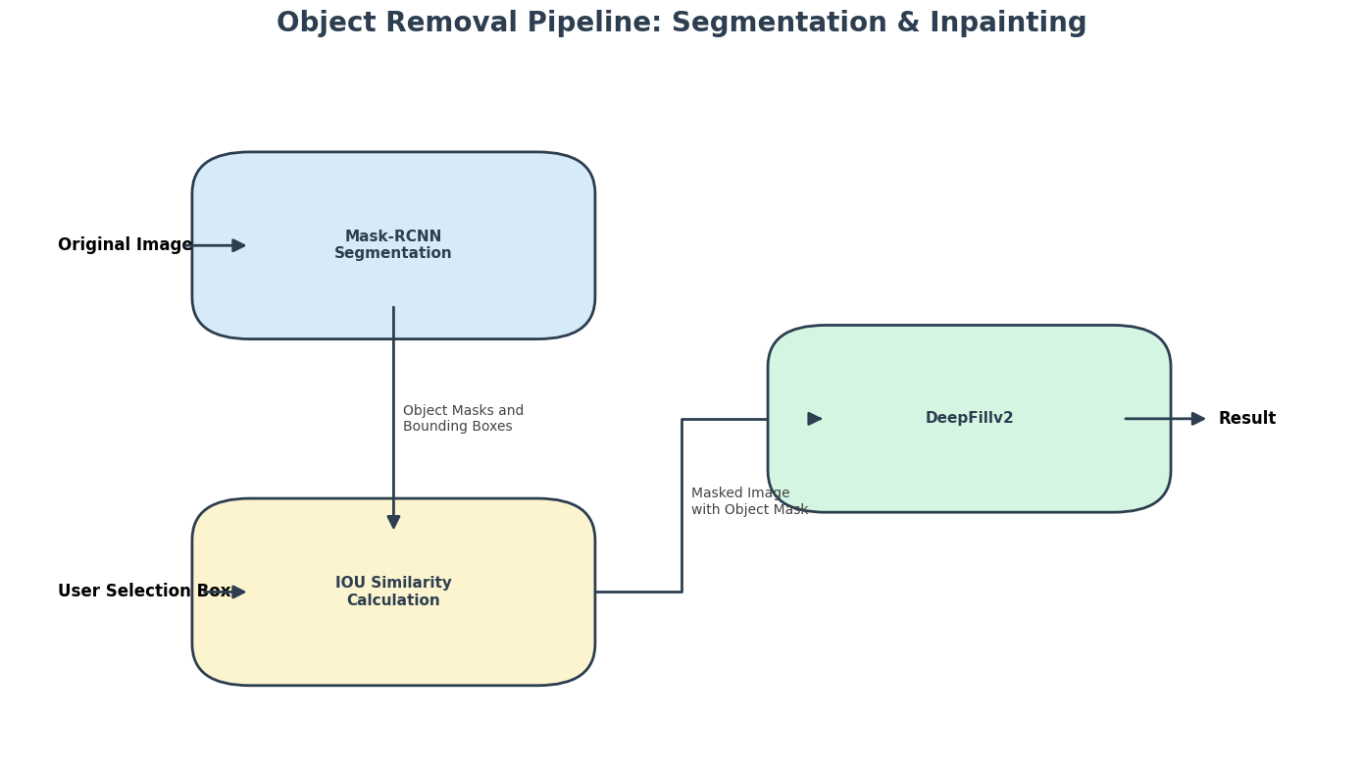
Methodology – Pipeline
Two-Stage Process
Object Masking
  Manual binary mask (white = object to remove)
  Created in GIMP/Photoshop
Image Inpainting (OpenCV)
  Diffusion-based: INPAINT_TELEA (Fast Marching), INPAINT_NS
  Exemplar-based: Criminisi-style patch matching
Simple, reproducible, computationally efficient

Slide 6
Inpainting Details
Diffusion-based (Telea/NS)
Propagates gradients inward from boundary
Best for small/smooth regions
Exemplar-based (Criminisi-inspired)
Priority: P(p) = Confidence × Data term (favors edges)
Best patch search via SSD
Copy & update → preserves textures/structures
Strengths complement each other

Slide 7
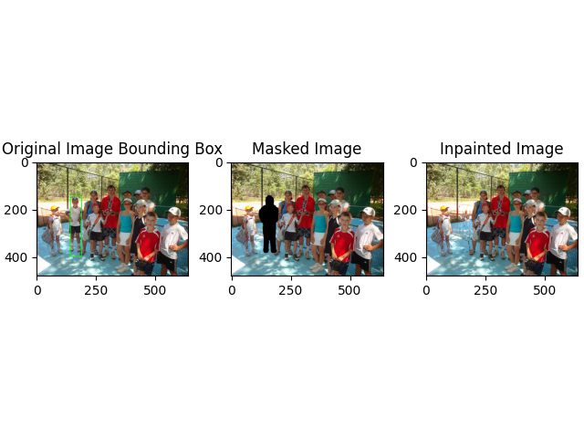
Results
Example 1: Group Photo

Slide 8
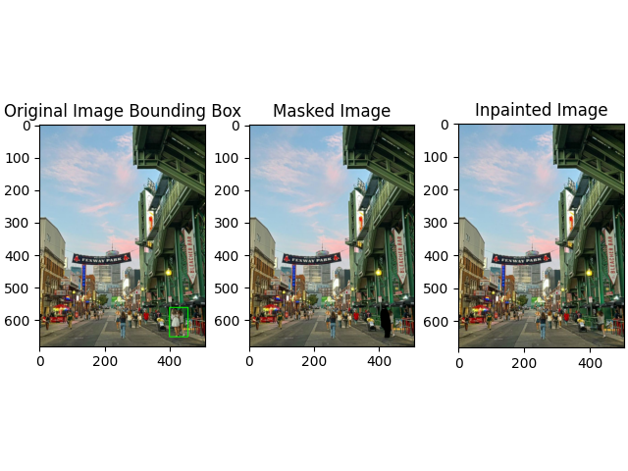
to be cont..
Example 2: Urban Scene (Fenway Park)

Slide 9
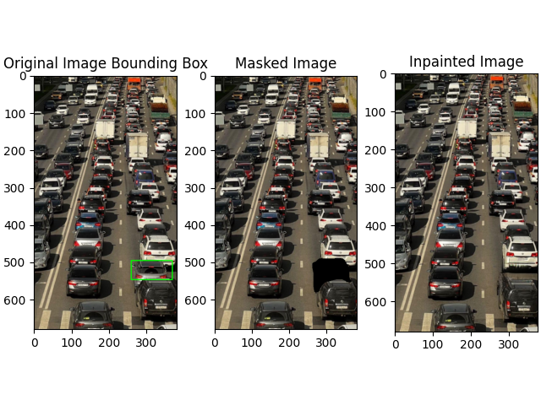
to be cont..
Example 3: Highway Traffic
Overall Performance
Strong: Small–medium masks (<15% area), repetitive/structured backgrounds
Weak: Large masks (>20–25%) → blurring, minor artifacts
Qualitative success in real-world enhancement

Slide 10
Discussion & Limitations
Classical methods: Fast, interpretable, reliable for moderate scenarios
Limitations:
No semantic understanding
Blurring/over-smoothing in large regions
Dependent on surrounding context
Modern deep learning (gated conv, diffusion models) far superior for complex cases
Project highlights evolution from local propagation to generative inpainting

Slide 11
Conclusion
Successfully demonstrated classical inpainting for object removal
Practical for photo cleanup; exposes clear boundaries of non-semantic methods
Future Work
Automatic masking (Mask R-CNN + user box)
Integrate deep learning (DeepFillv2, LaMA)
Hybrid approaches, video extension, quantitative benchmarks
Thank you!

